Slide 1

Bluetooth Tracking for Activity Recognition
Amanda Watson
Advanced Computer Networking

Slide 2
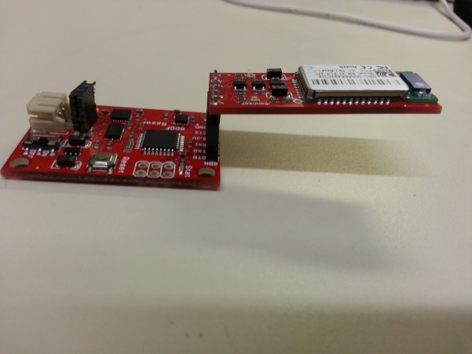
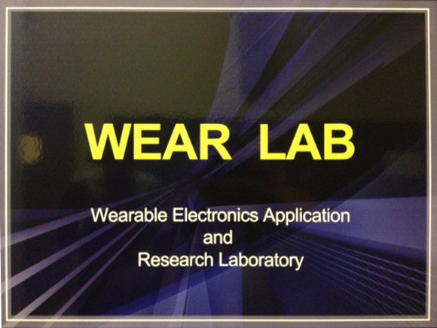

Problem
Activity recognition generally requires additional hardware that can be bulky and expensive.
This hardware can suffer from body fading which can require additional hardware for storage of information.

Slide 3

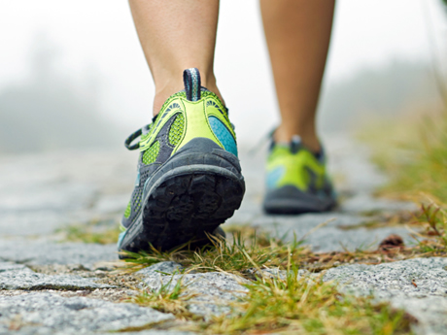
Problem
Current activity recognition hardware and software is not always accurate.

Slide 4

Research Questions
Can we use the impermeability of the human body for Bluetooth activity recognition?
Will the Bluetooth data be accurate enough to distinguish between different activities?

Slide 5
Related Work
An activity monitoring system has been implemented using the Zigbee protocol, RadioSense: Exploiting Wireless Communication Patterns for Body Sensor Network Activity Recognition.
Zigbee is not generally used in commercial products, while Bluetooth is.
Bluetooth devices are already in use and can be used for activity recognition.
Using the devices consumers already own makes this system easier to implement.
PBN: Towards Practical Activity Recognition Using Smartphone-Based Body Sensor Networks

Slide 6
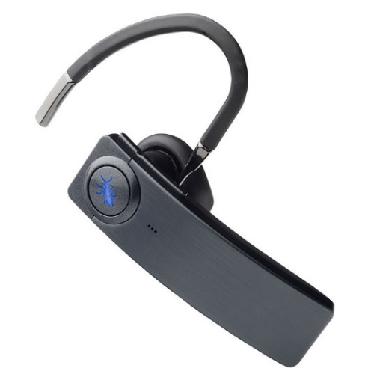
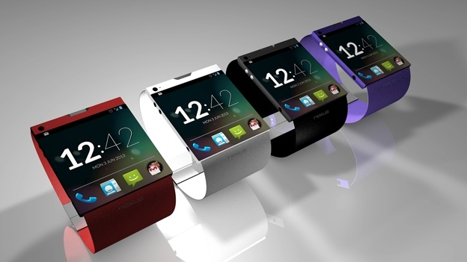
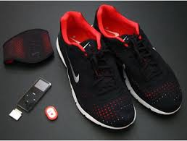
Contributions
Using Bluetooth RSSI values, it is possible to distinguish between activities
Existing body sensor networks can be used for activity monitoring

Slide 7
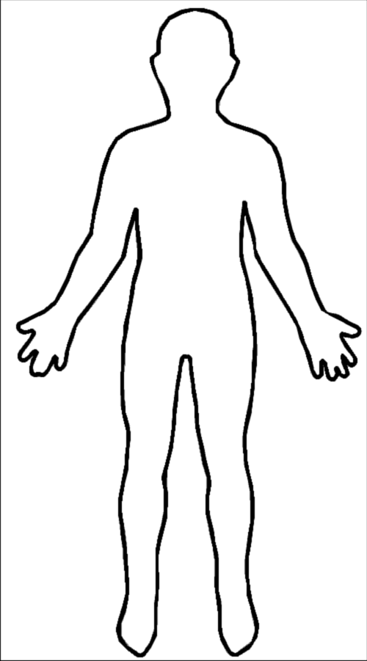
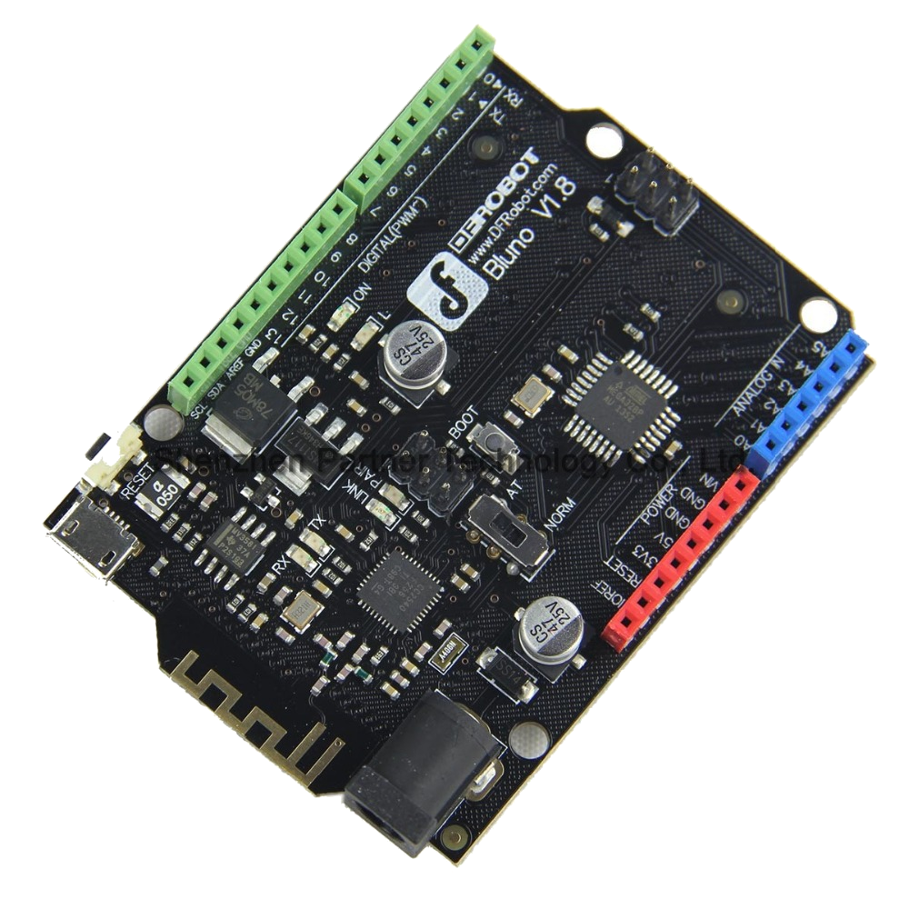
Details
4 Bluetooth chips
Allows for:
Different Body Positions
Different Activities

Slide 8
Stationary Activities
Sitting Vs Standing
RSSI Values are not constantly changing
Node | Left Ankle | Right Ankle
Sitting(Feet on Floor) | 93-100 | 93-100
Sitting (Crossed Legs) | 75-80 | 75-80
Sitting(Legs out) | 75-85 | 75-85
Standing | 85-95 | 85-95
*RSSI Values

Slide 9
Movement Base Activities
Classification relies on time slices
Walking vs Running
 | Front Foot | Back Foot
RSSI | 80-85 | 70-75
 | Steps per Minute
Walking | 130-135
Running (10 min mile) | 200-220

Slide 10
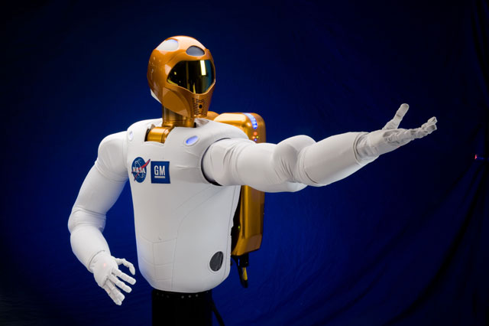
Manipulation Based Activities
Stationary
Leg nodes have relatively constant RSSI values
Examples: eating, homework
Movement
Ankle nodes have show walking and standing
Examples: cleaning, cooking
The wrist nodes do not show constant data
Patterns emerge when eating
Working on homework, cleaning and cooking are more sporadic

Slide 11
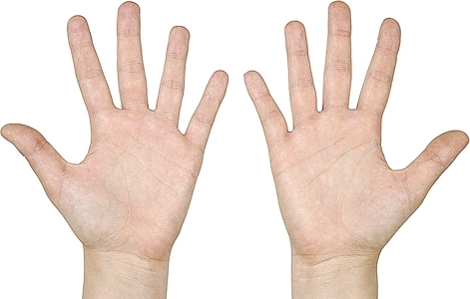
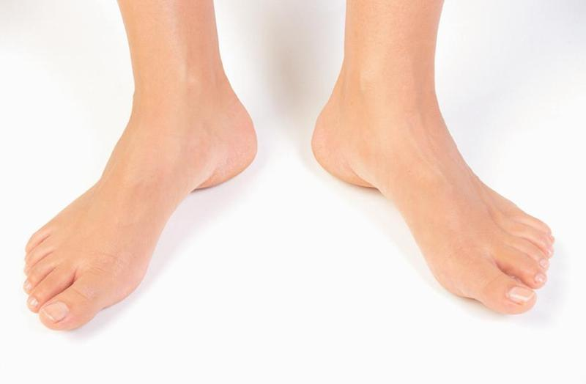
Things to Note
Feet are used for movement
Hands are used for manipulation
Currently this system requires previous knowledge of node locations
Smart phone location must stay in a general, constant location

Slide 12
Future Work
Incorporate already existing body sensor nodes
Smart watches, google glass, Fitbit
Auto-detect where nodes are located by holding the smartphone in one location
Work around the need for the smartphone to be stationary
Add in more activities:
Recognize different sports
Add more manipulation based activities

Slide 13
Questions?

